Slide 1
SOFTWARE PACKAGE DESVELOPMENT CLASSMATE
Team Number :
6
Team Members
1.Srivathssan V V (19z247)
2.Kousik Nibith Ram V P (19z253)
3.Vignesh M (19z258)
4.Sruthi S(20z434)
5.Udhayakumaran H (20z435)
6.Vignesh A(20z436)

Slide 2
CLASSMATE
INTRODUCTION:
This is an user friendly portal that provides different features such as enabling the administrators to manage the mentors,facilitating the mentors to continuously monitor and enhance students and it also acts as a useful platform for the students to view the academic details and schedules.
PROBLEM STATEMENT:
To build an application that is capable of efficiently satisfying the colloborative needs of students,mentors and administrators in different aspects.

Slide 3
OBJECTIVE
This Project “The ClassMate” attempts to serve as a virtual classroom
which connects the Instructors and Students.
●Its motive lies in serving the purpose of bridging the gap between real-time
and online classes
●This piece of software allows instructors to schedule tests and webinars ,
grade students and mark their attendance etc
● An Instructor will be able to guide the students under him/her and track
their attendance progress and their grades
●In total this website attempts to mimic the Google Classroom

Slide 4
REQUIREMENTs Gathering
Admin
Add Student/Mentors
Change Mentors
View Feedback
Dashboard
Instructor
Add Classroom
Add tests/webinars
Grade Tests
Mark Attendance
Dashboard
Student
View Classrooms , test and webinars
Upload Answer Scripts
Give Feedback
View Profile

Slide 5
REQUIREMENTs Gathering
Admin
1.Add Student/Instructors
The admin can add new students and instructors to the database by entering their details
2.Change Mentors
The admin can change the mentor assigned to a student if he wishes
3.View Feedback
The feedbacks of the students regarding the faculties can be viewed by the admin to track the instructors’ progress.
4.Dashboard:
The admin can view the total list of students with their attendance percentage , grades and mentors with ratings

Slide 6
REQUIREMENTs Gathering
Mentor
1.Add Classrooms :
The Instructor can add new classrooms for specific topic handled by that mentor
2. Schedule Tests/Webinars :
The mentor can add tests and webinars under a specific classroom by entering their details and uploading question papers
3.Grade Students
The instructor can grade the students for those completed tests
4.Mark Attendance
The instructor can mark the attendance for the students for a specific webinar
5.Dashboard
The Instructor can view the total list of students under him/her according to their grades and attendance

Slide 7
REQUIREMENTs Gathering
Student
1.View Classrooms
The students can view the classrooms added by their instructors
2.View Scheduled Tests/Webinars
The students can view the scheduled tests and webinars under each classrooms and upload answer scripts
3.Give Feedback
The students can give their feedbacks regarding their instructors teachings and also give the ratings.
4.View Profile
The students will have a personal dashboard where they can track their progress and their attendance and grades

Slide 8
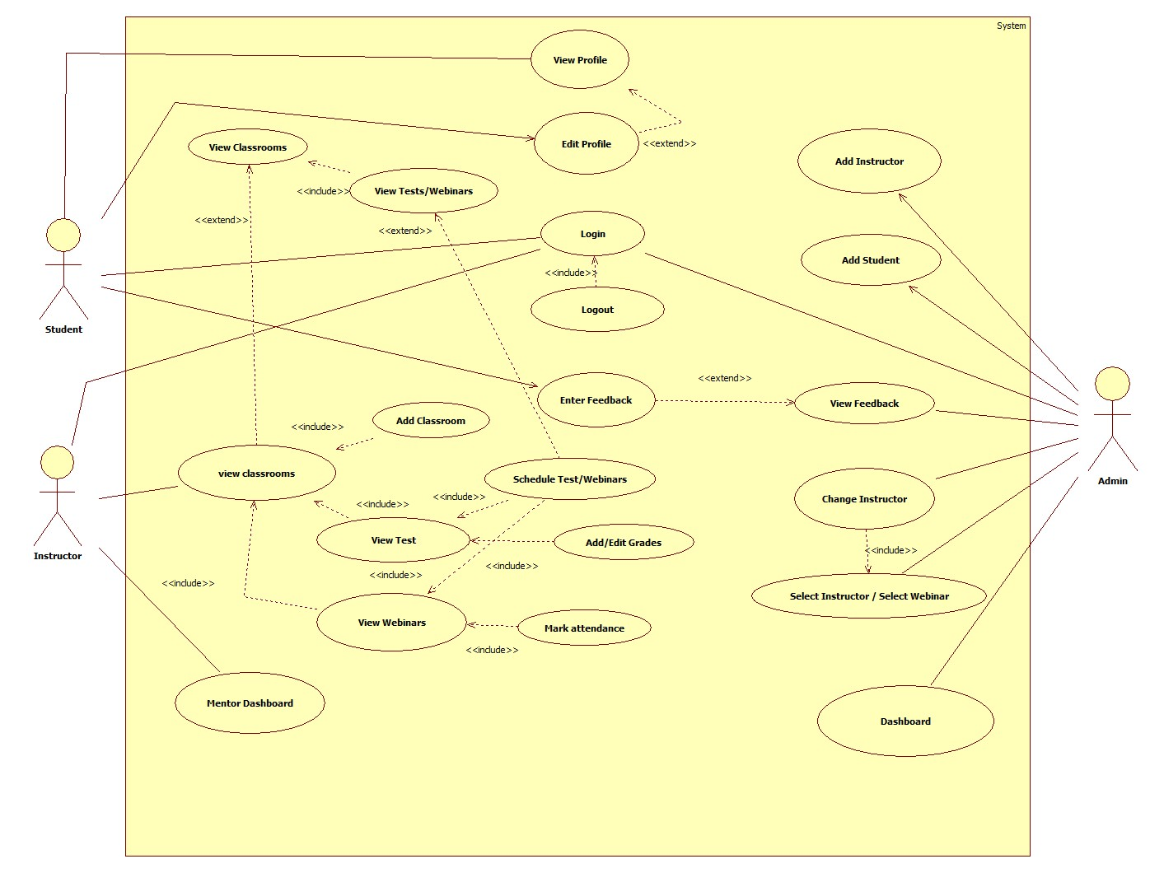
USECASE DIAGRAM

Slide 9

FRONT END-HTML
HyperText Markup Language (HTML) is the set of markup symbols or codes inserted into a file intended for display on the Internet. The markup tells web browsers how to display a web page's words and images.

Slide 10

FRONT END-CSS
CSS stands for Cascading Style Sheets, and it's used to add style to a web page by dictating how a site is displayed on a browser. CSS is unique in that it doesn't create any new elements, like HTML or JavaScript. Instead, it's a language used to style HTML elements.

Slide 11

BACK END-NODE JS
It is used for server-side programming, and primarily deployed for non-blocking, event-driven servers, such as traditional web sites and back-end API services, but was originally designed with real-time, push-based architectures in mind. Every browser has its own version of a JS engine, and node.

Slide 12

BACK END-MONGO DB
MongoDB is a document database used to build highly available and scalable internet applications. With its flexible schema approach, it's popular with development teams using agile methodologies.

Slide 13
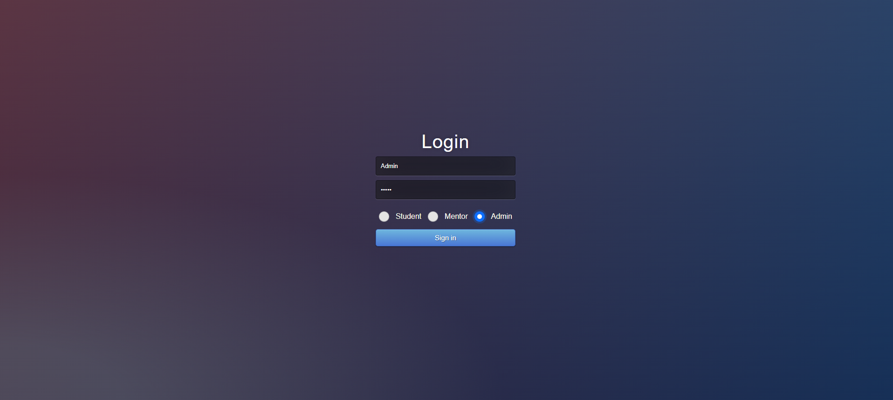
Admin Login

Slide 14
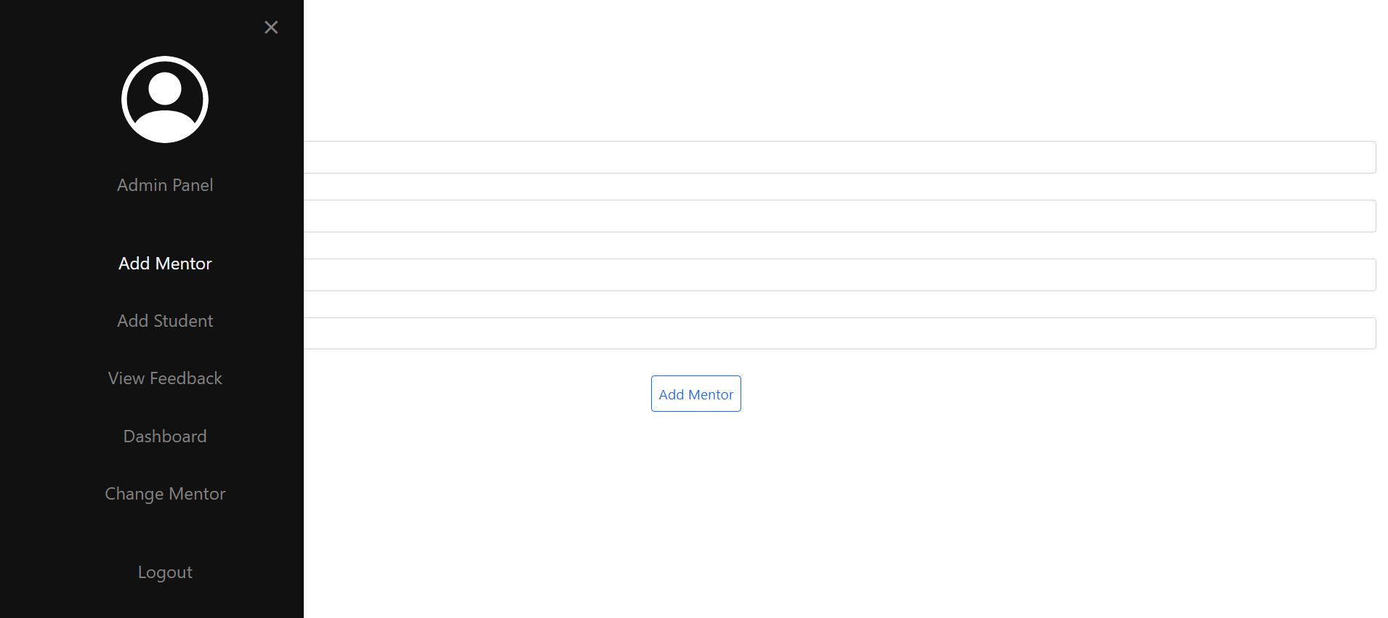
Navigation Bar

Slide 15
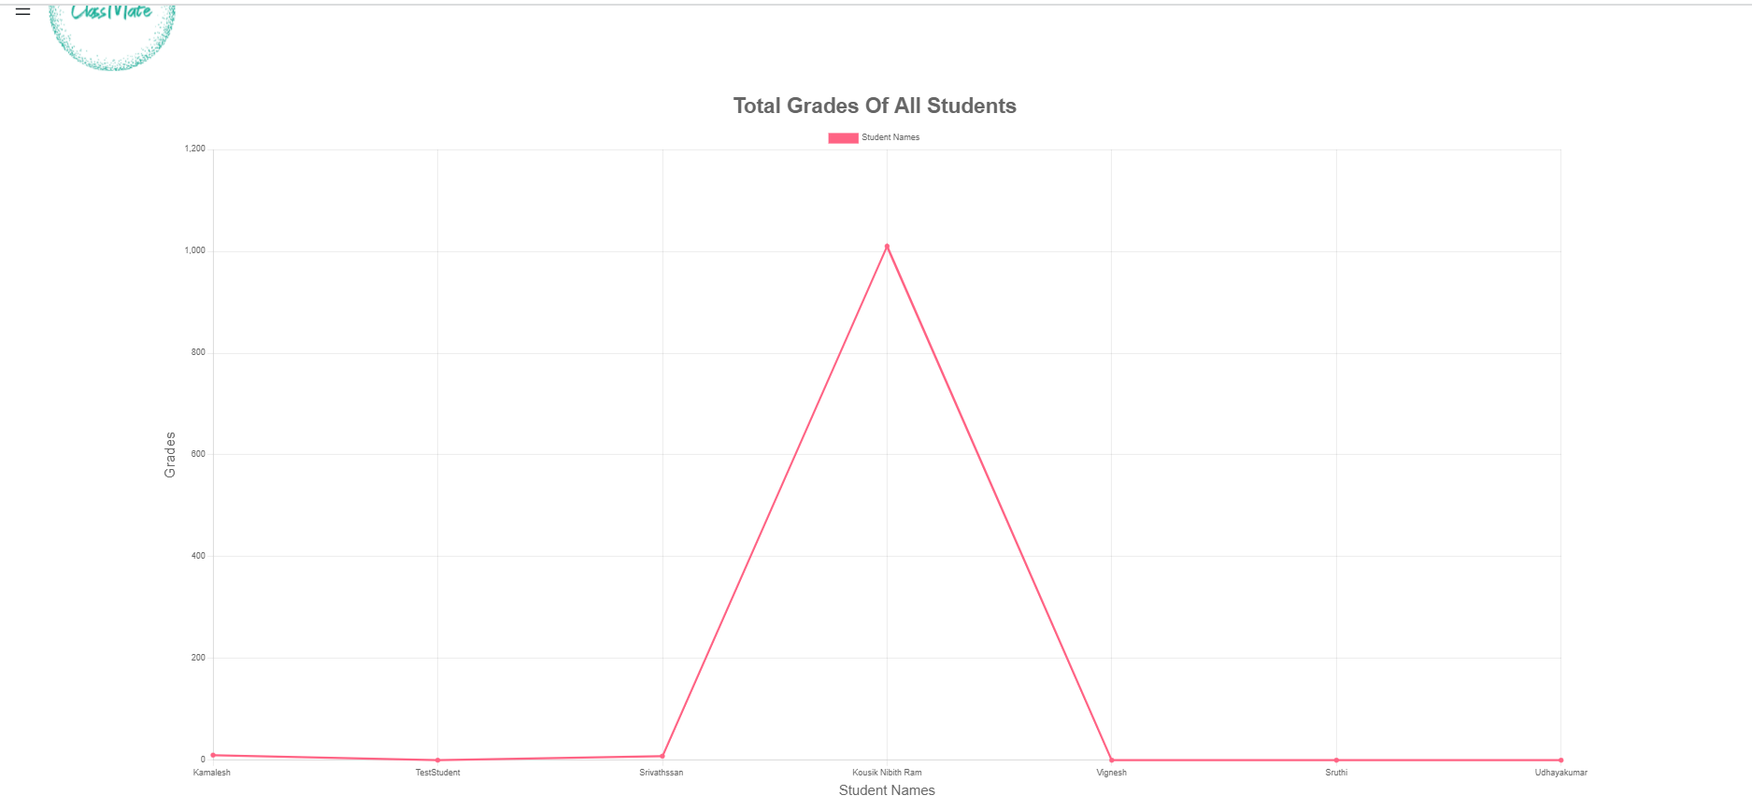
Admin Home Page Grade Graph

Slide 16
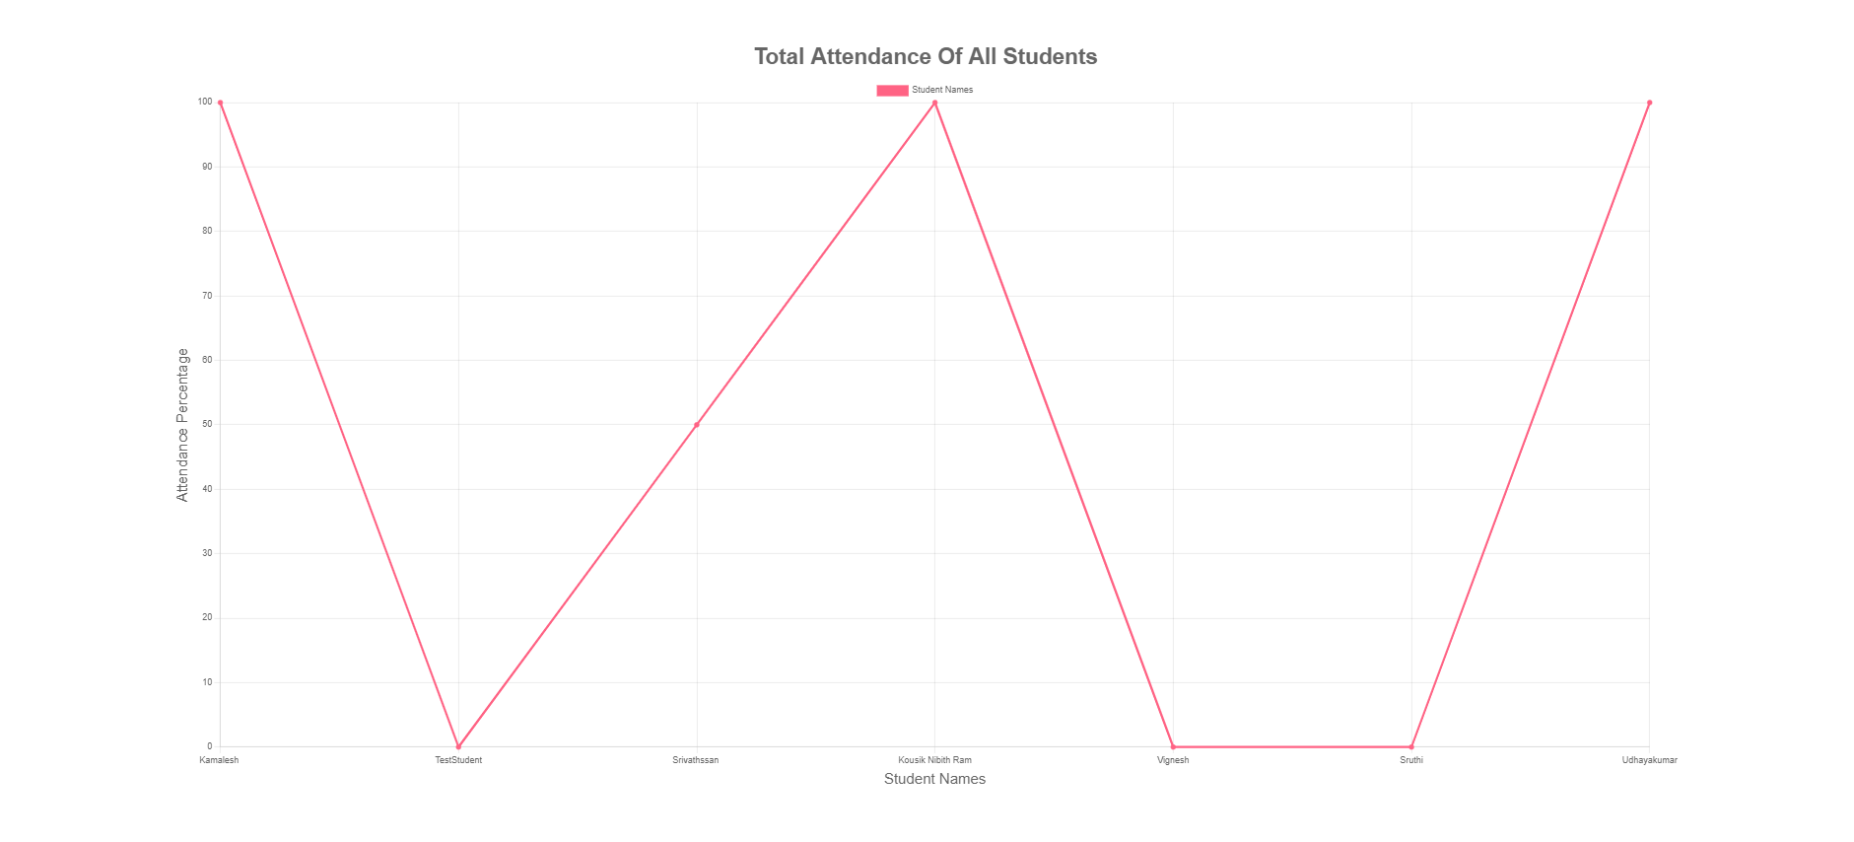
Admin Home Page Attendance Graph

Slide 17
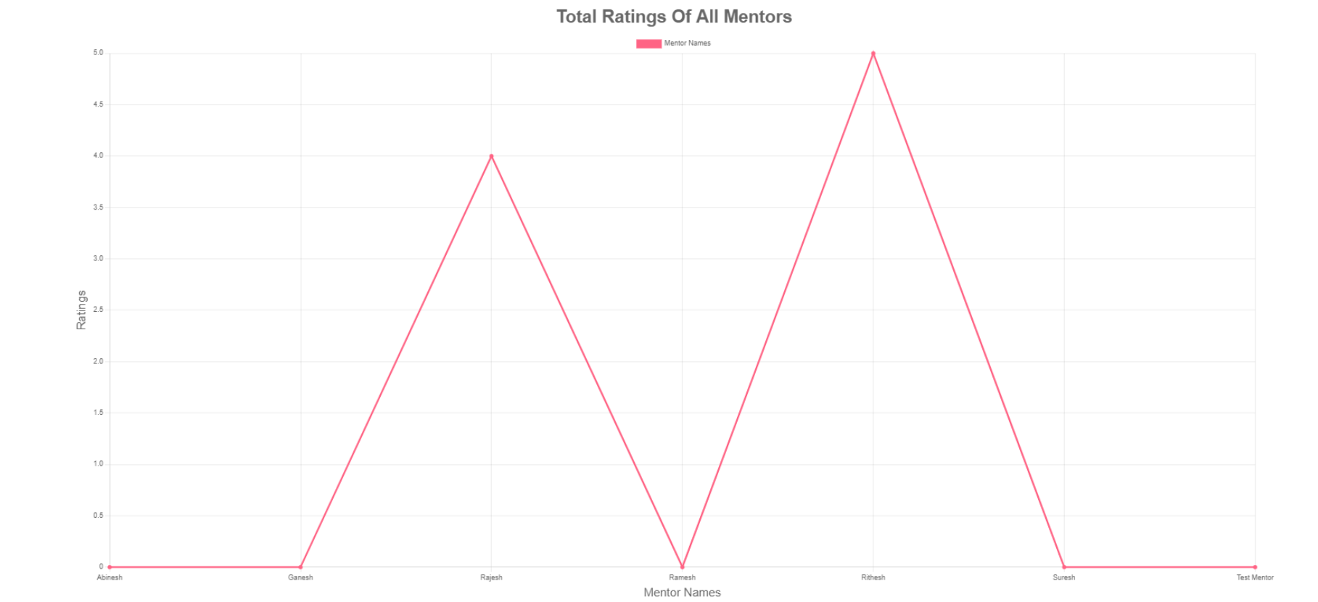
Admin Home Page Mentor Graph

Slide 18
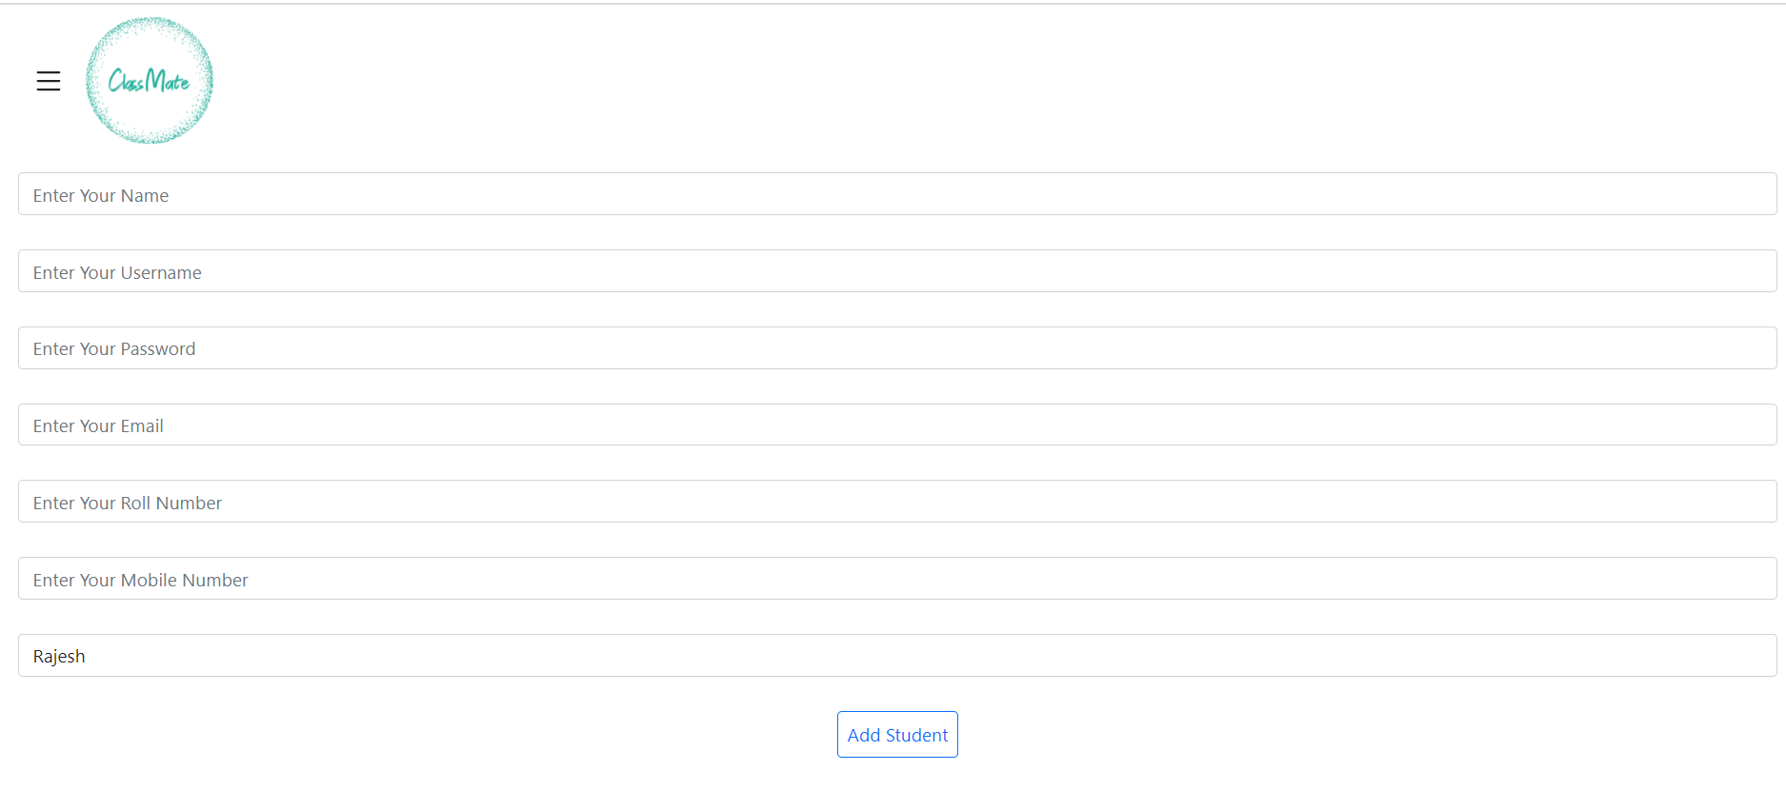
Add Student

Slide 19
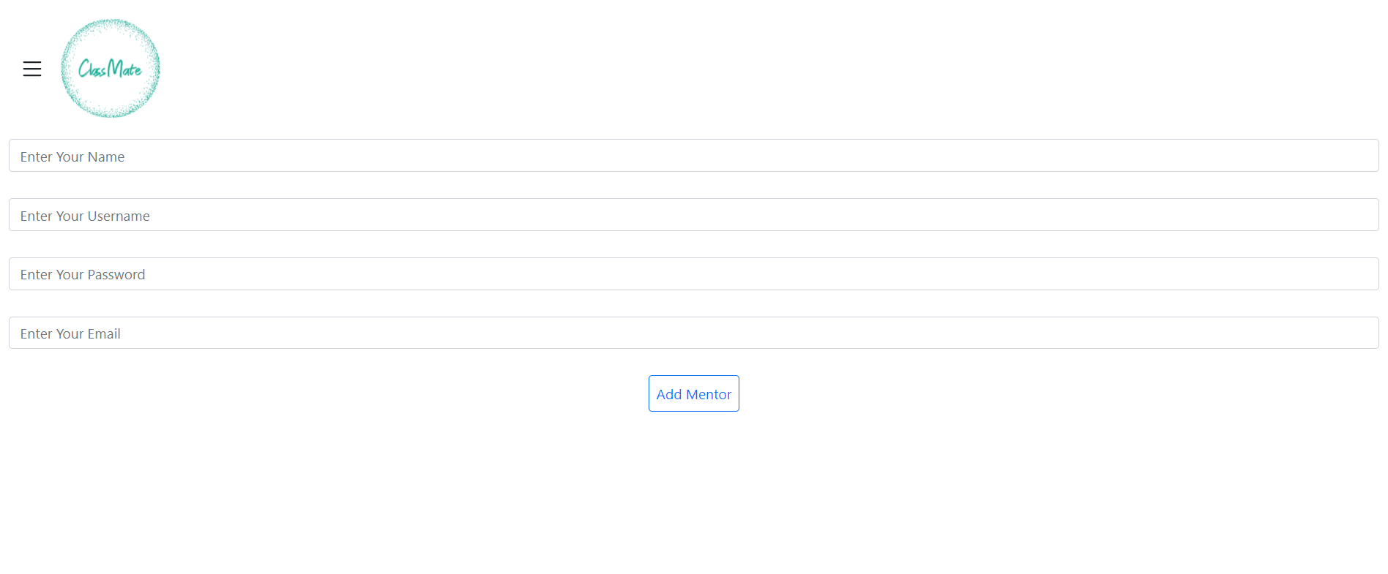
Add Mentor

Slide 20
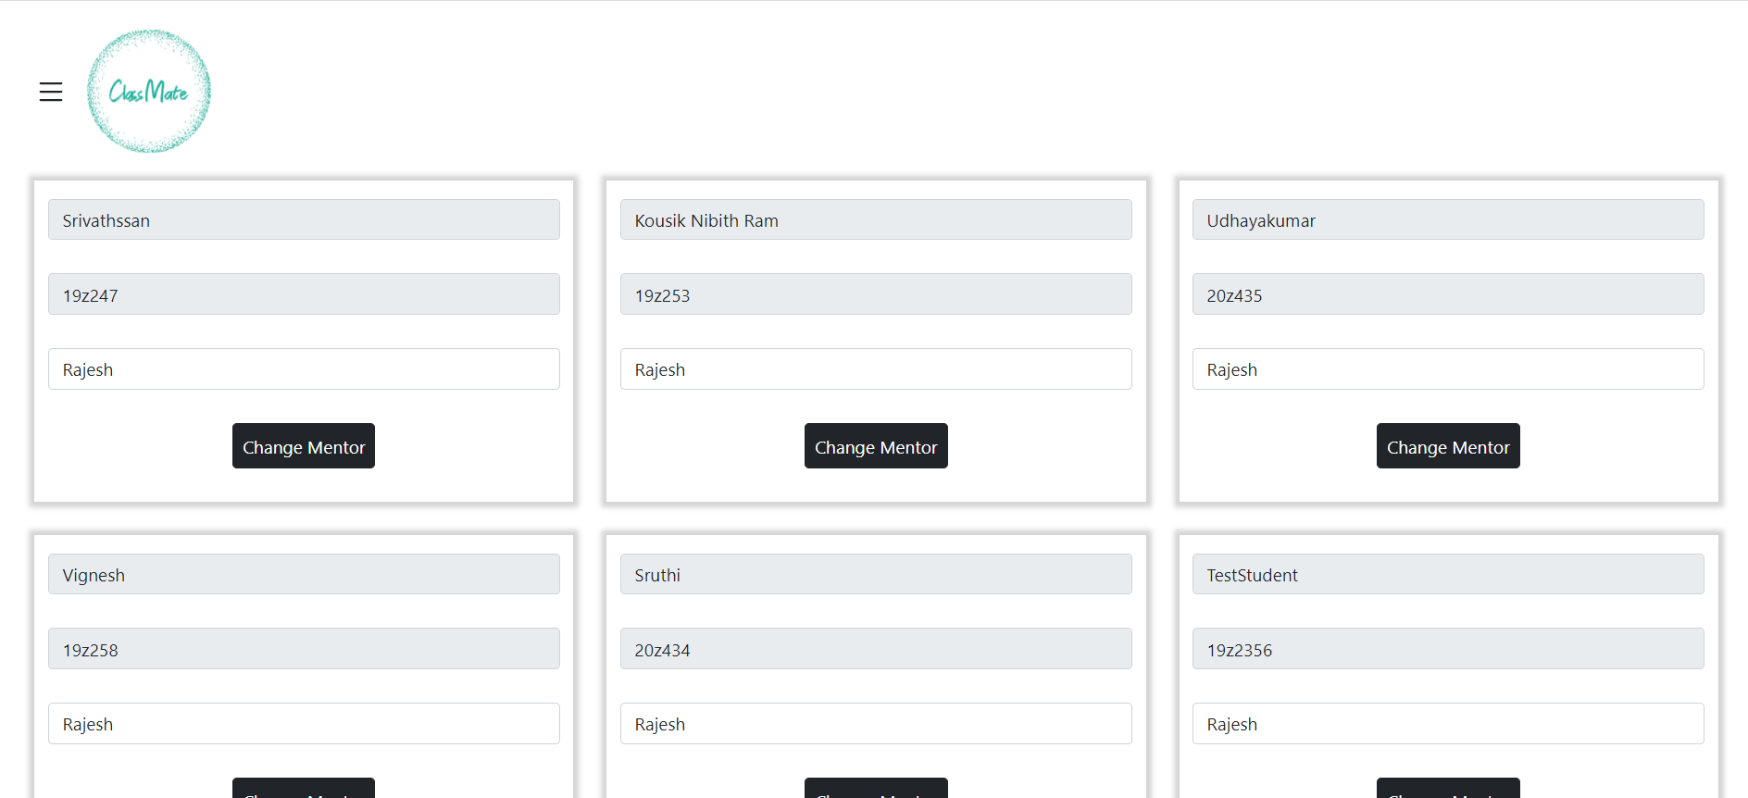
Change Mentor

Slide 21
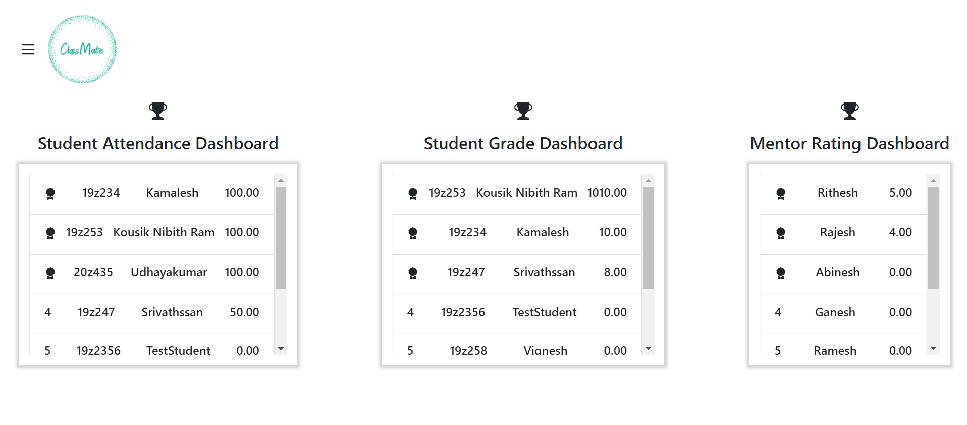
Admin Dashboard

Slide 22
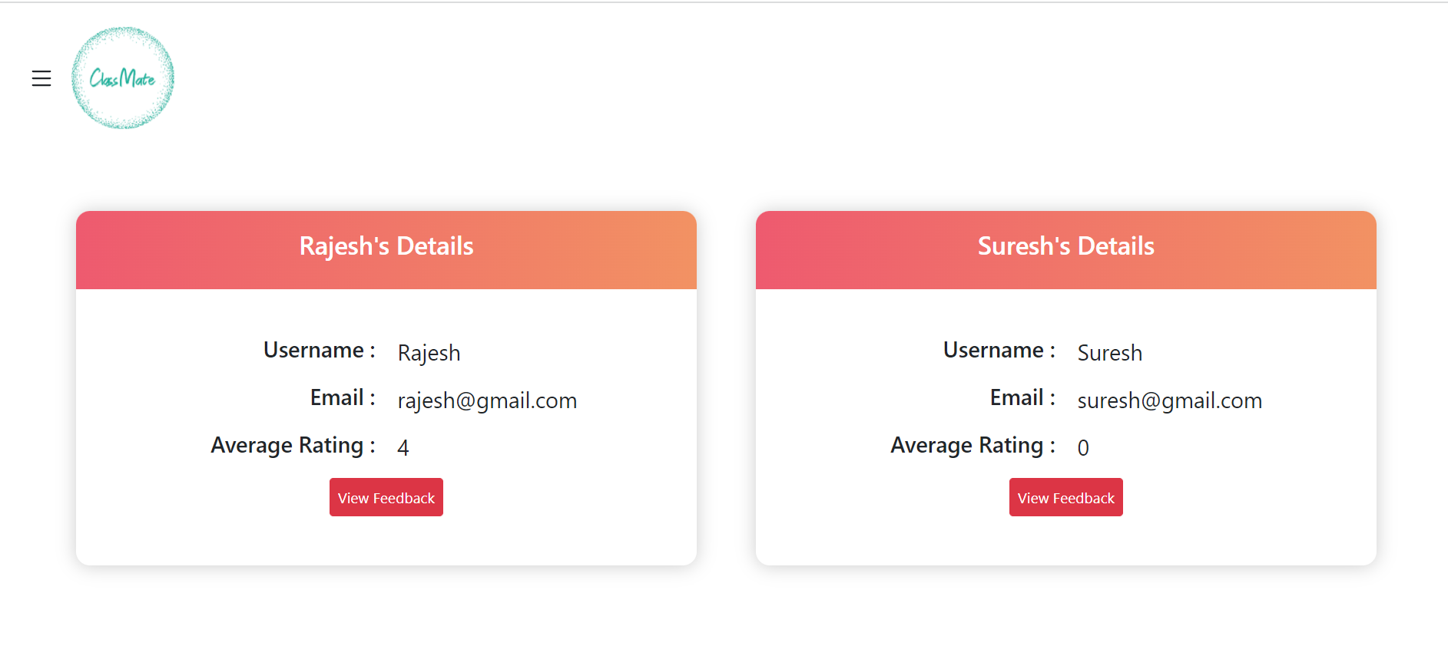
View Feedback

Slide 23
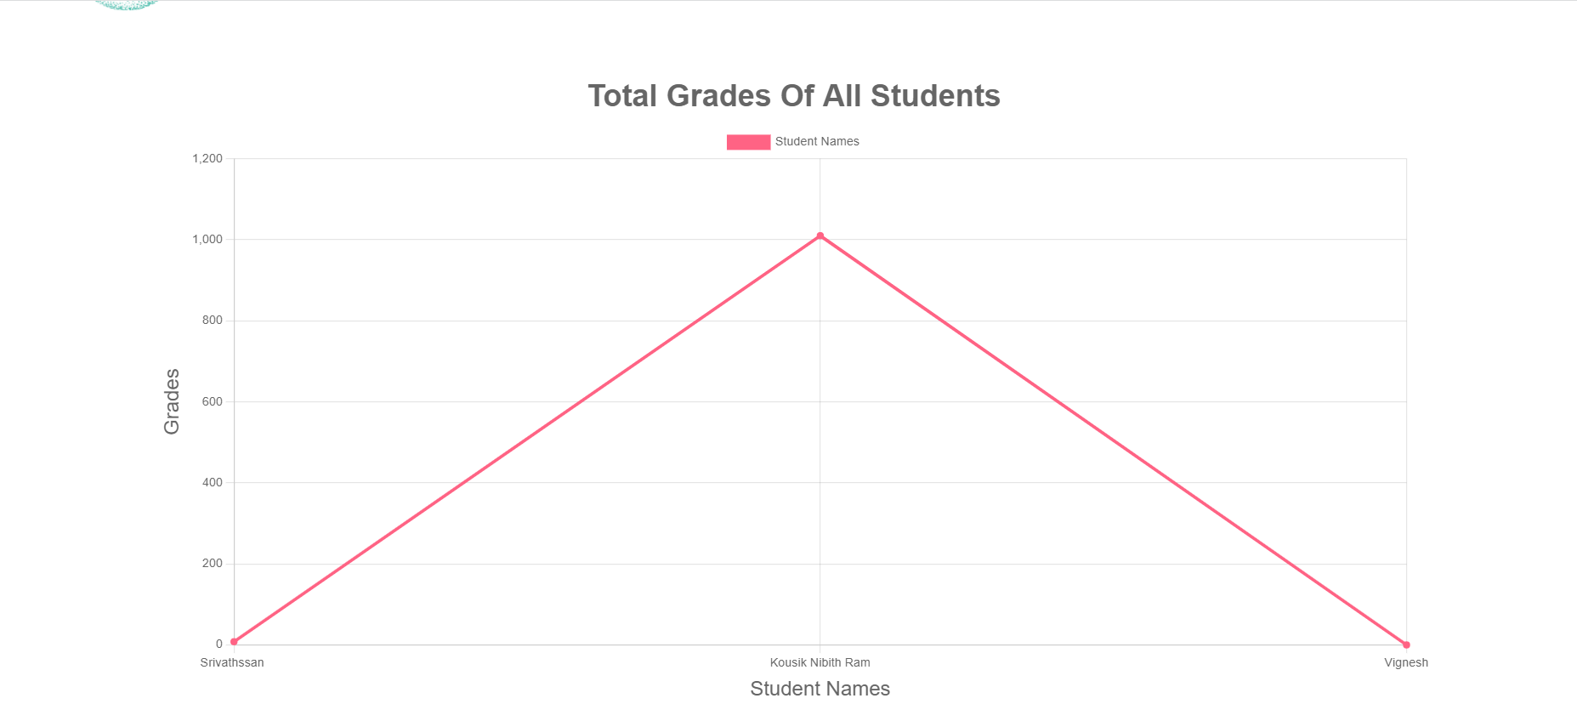
Mentor Home Page Grade Graph

Slide 24
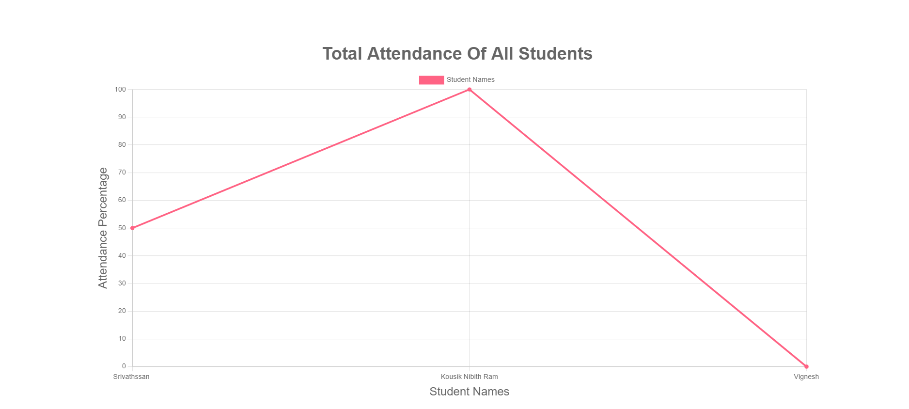
Mentor Home Page Attendance Graph

Slide 25
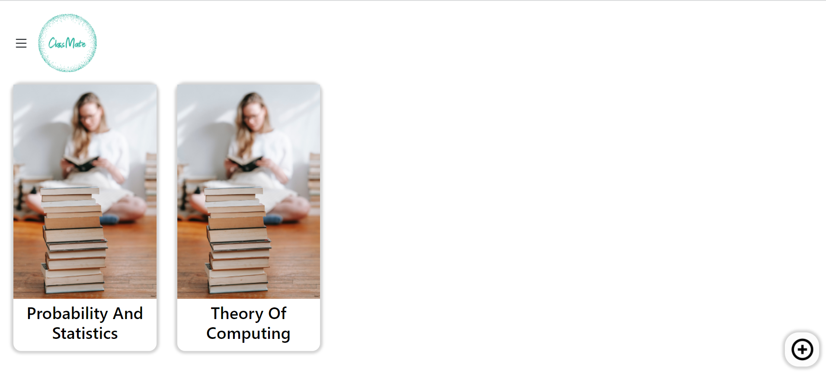
Classroom Page

Slide 26
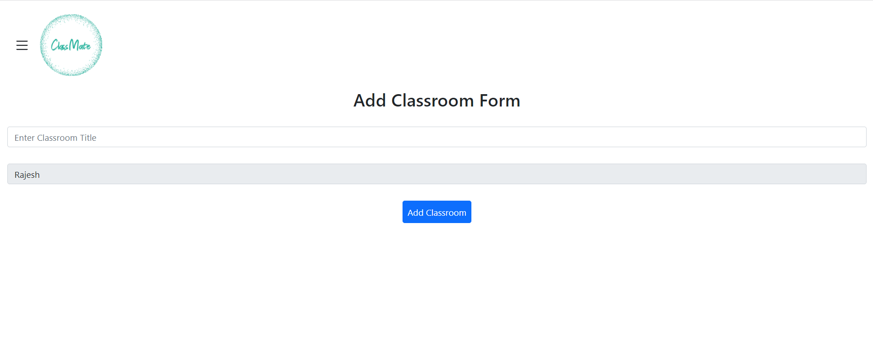
Add Classroom Page

Slide 27
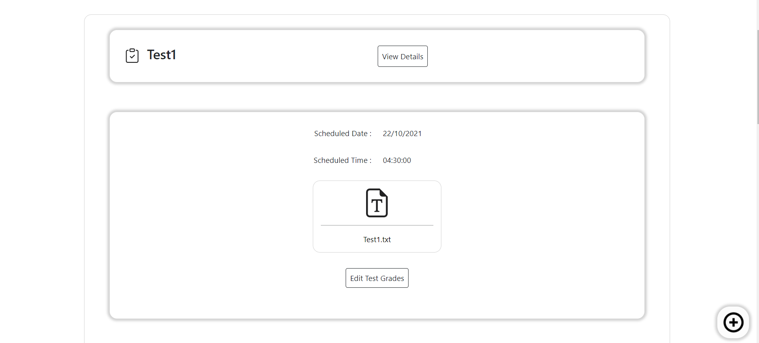
Test Page

Slide 28
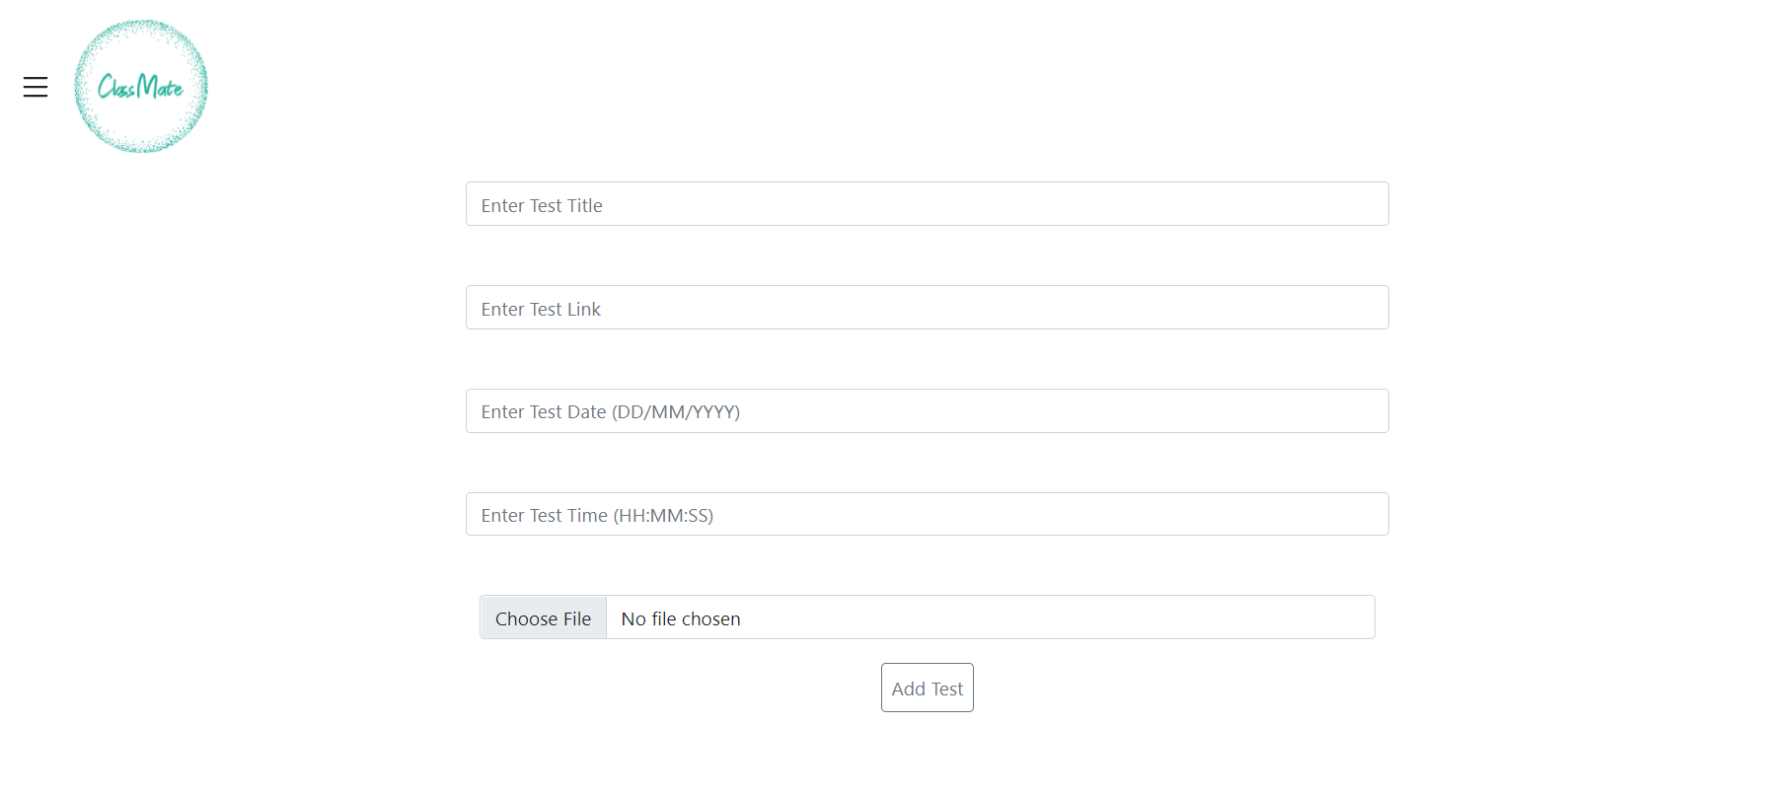
Add Test Page

Slide 29
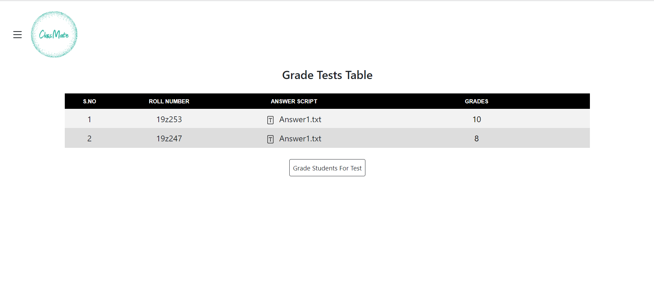
Edit Grades Page

Slide 30
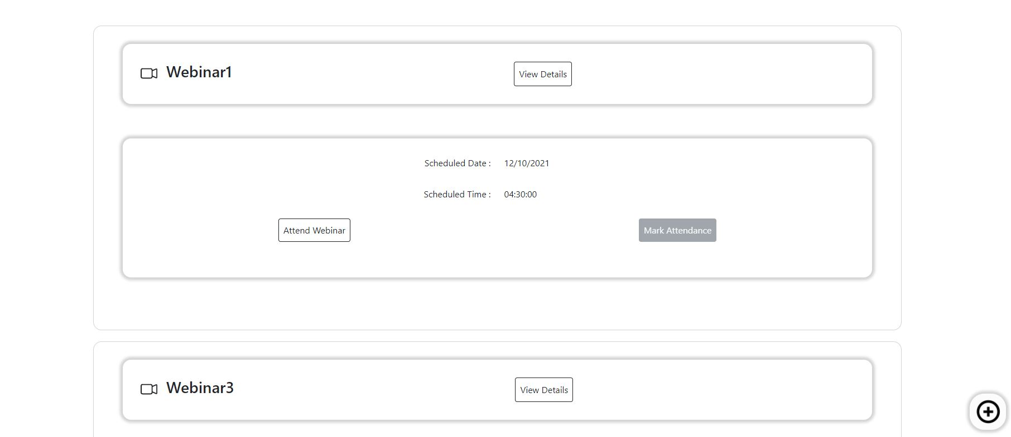
Webinars Page

Slide 31
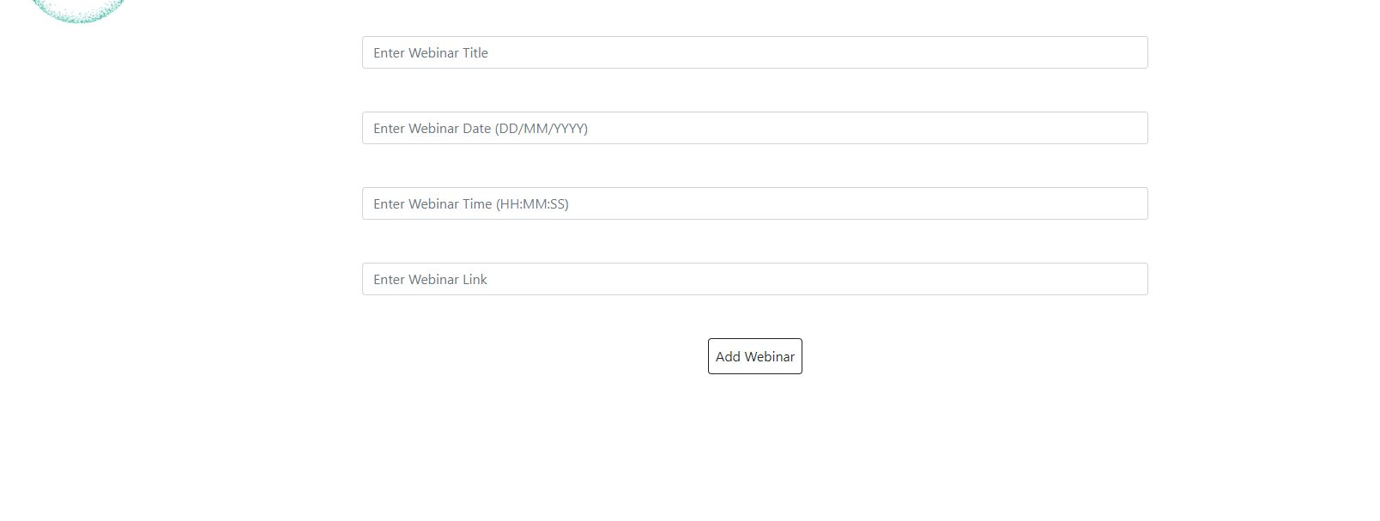
Add Webinars

Slide 32
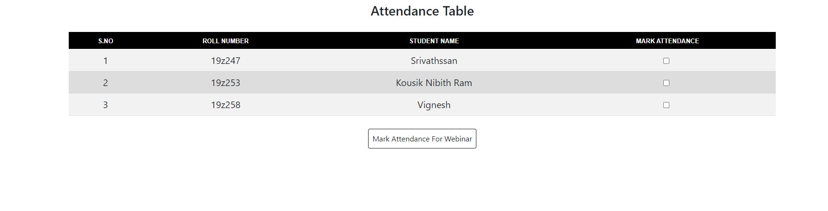
Mark Attendance Page

Slide 33
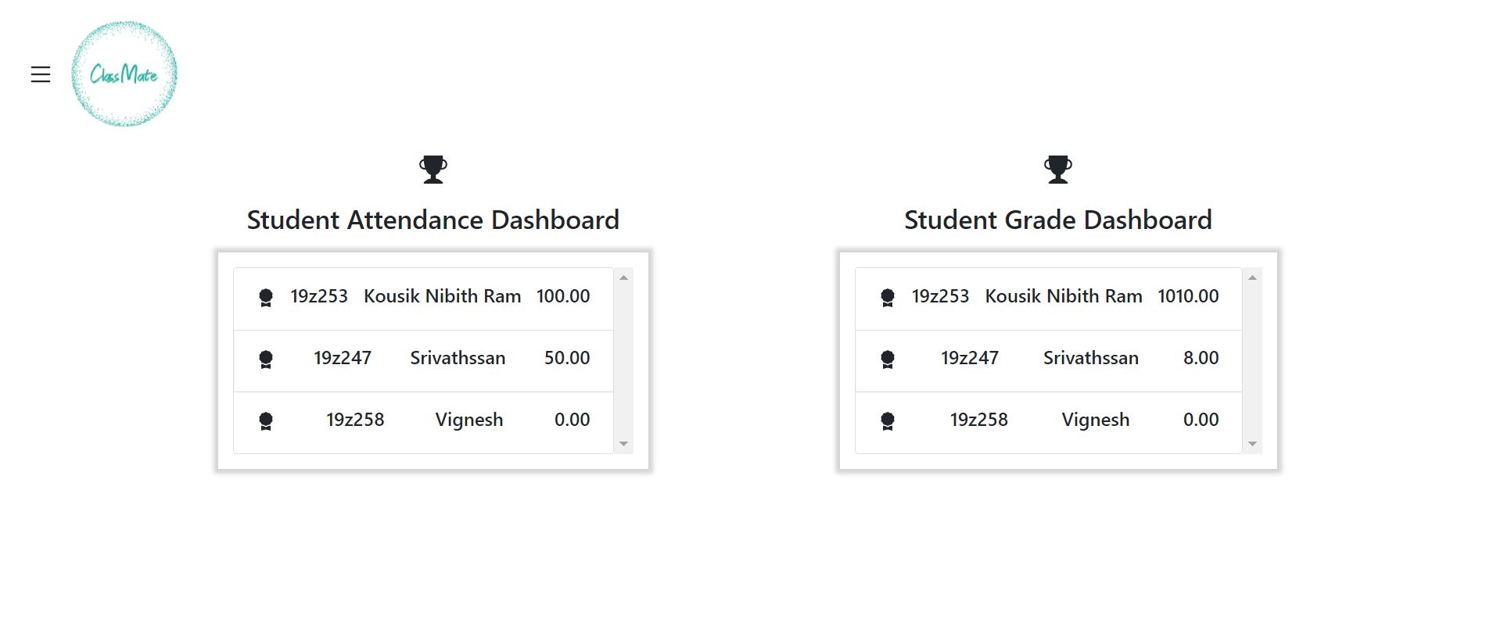
Mentor Dashboard

Slide 34
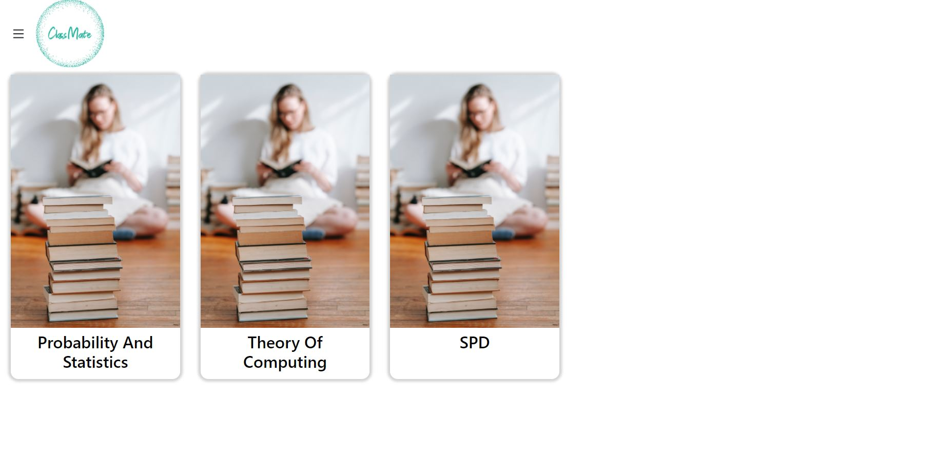
Student Home Page

Slide 35
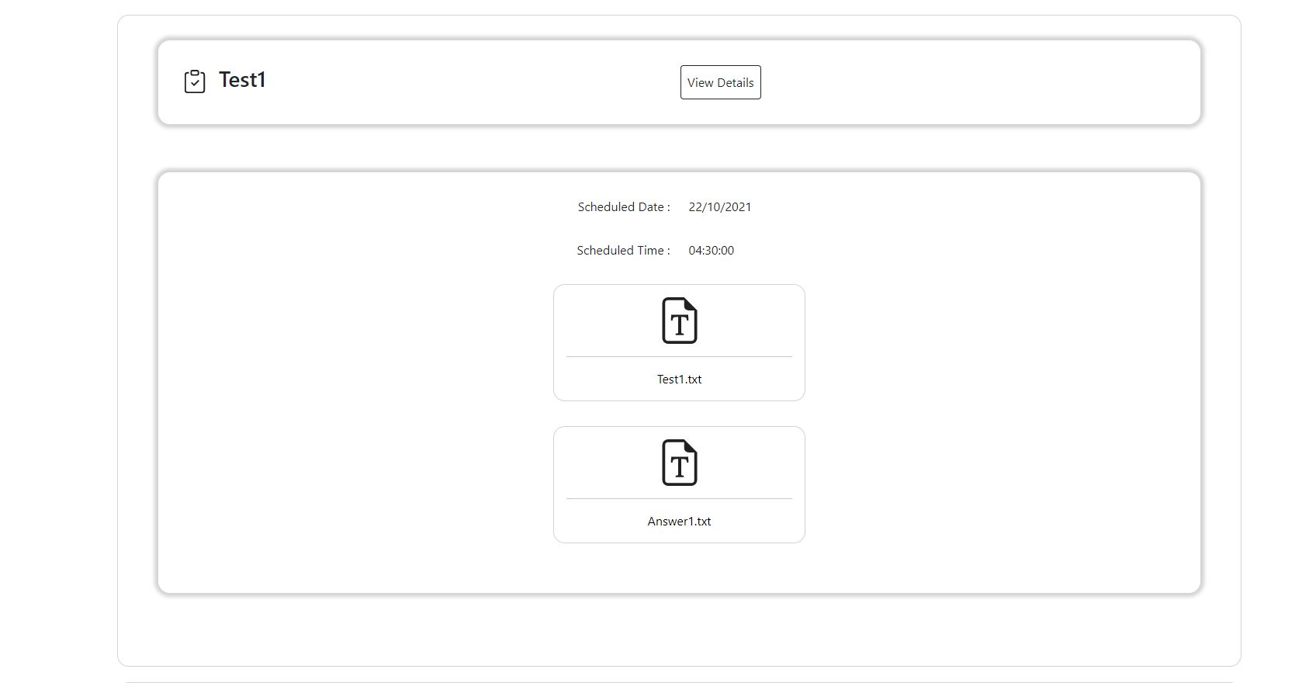
Student Tests With Answer Scripts

Slide 36
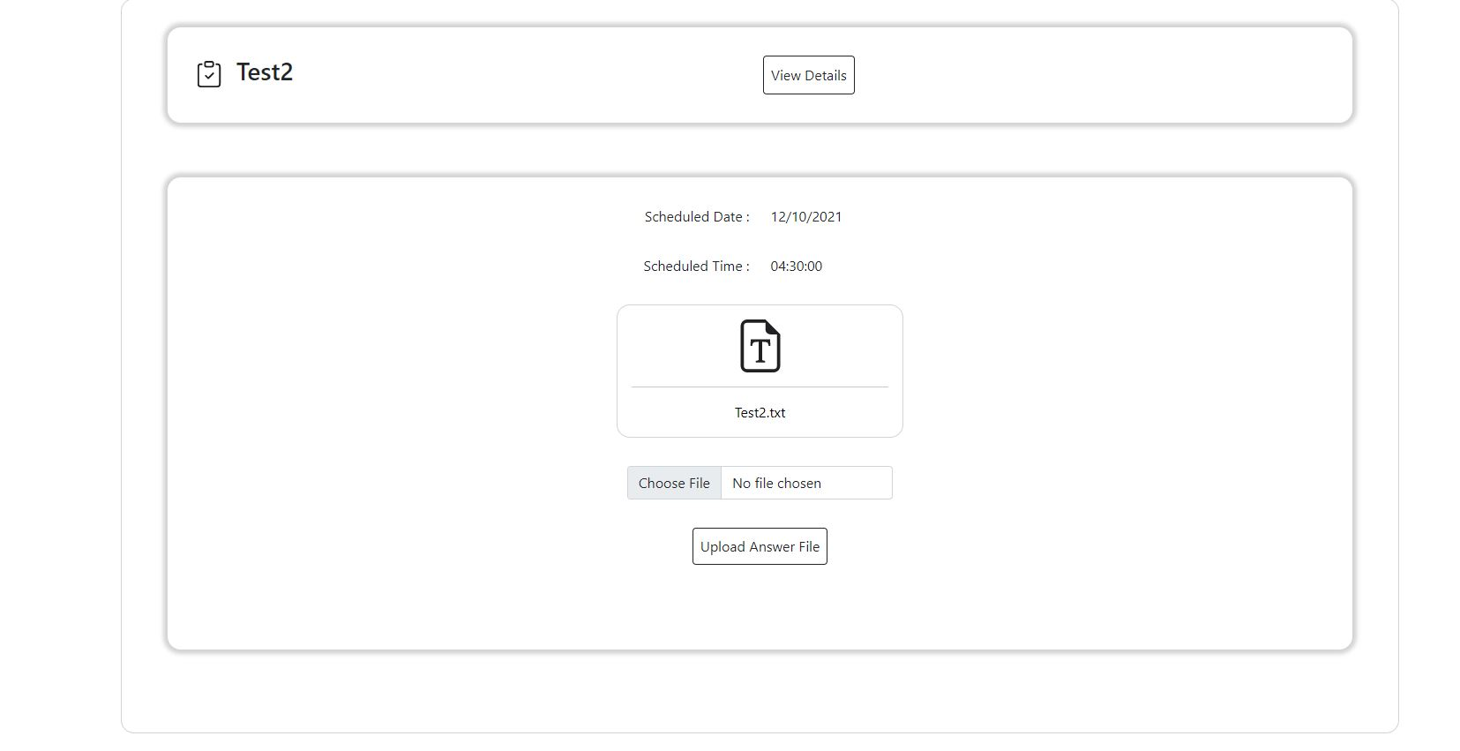
Without Answer Scripts

Slide 37
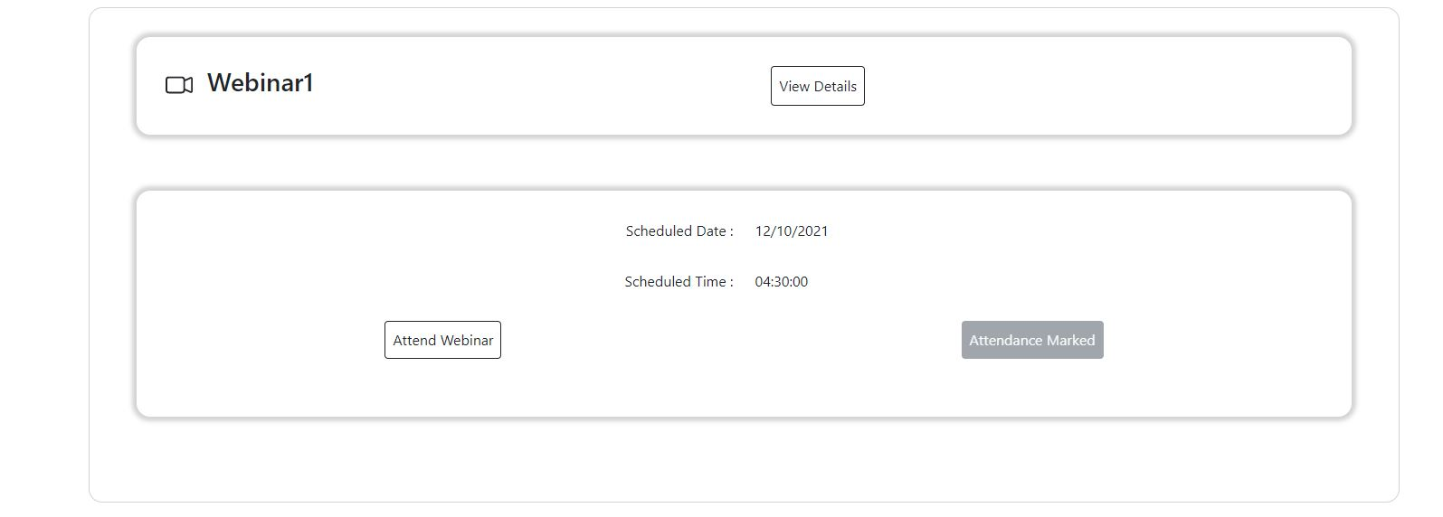
Student Webinars

Slide 38
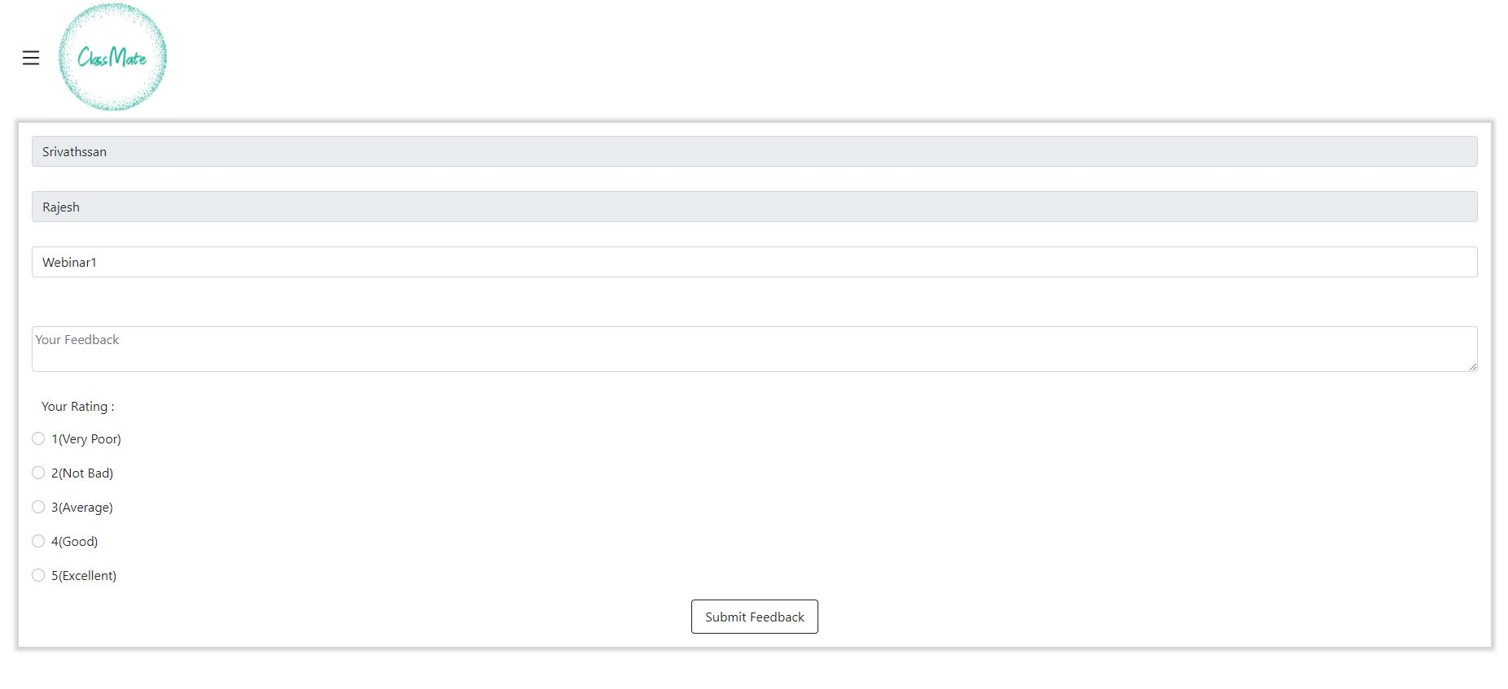
Student Feedback Form

Slide 39
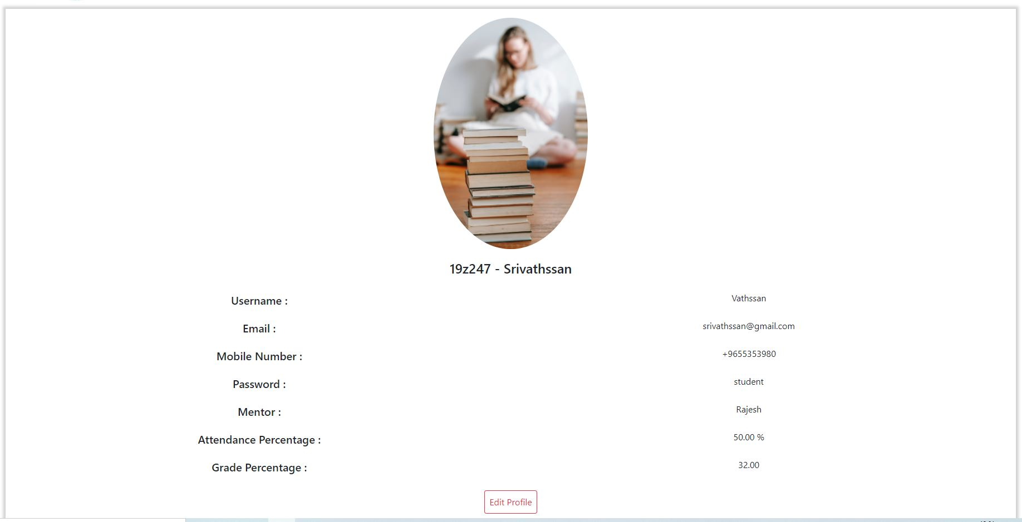
Student Profile Page

Slide 40
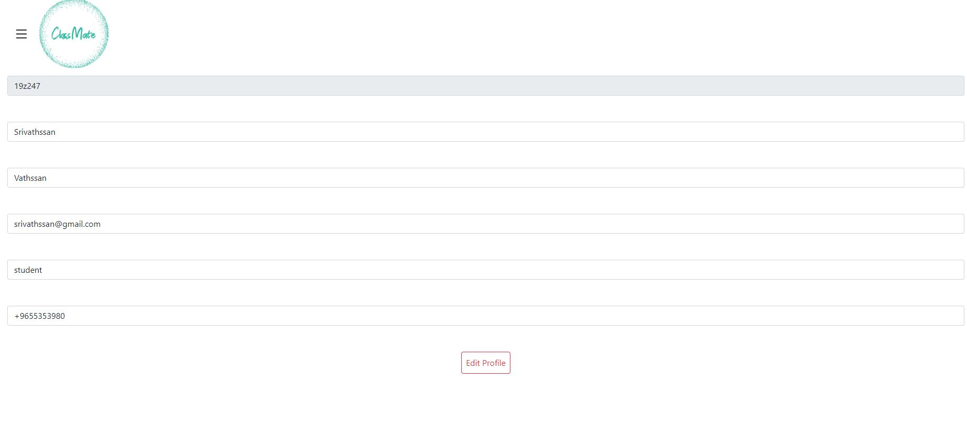
Edit Profile

Slide 41
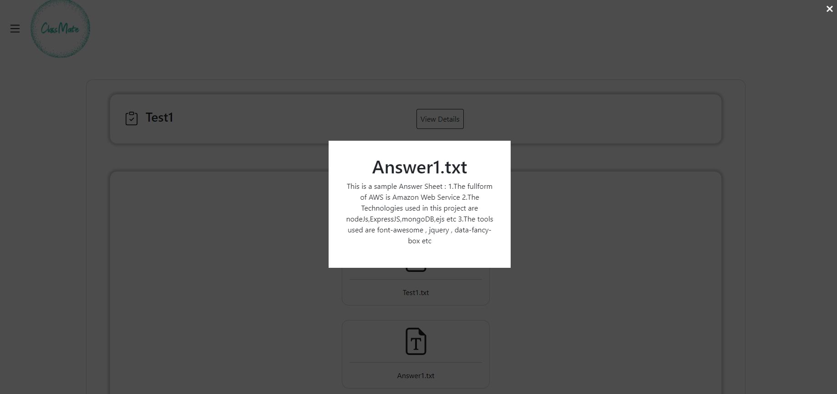
Popup Page

